Slide 1
P, NP, NP-Hard & NP-complete Problems
Lecture – 71-72

Slide 2
Objectives
P, NP, NP-Hard and NP-Complete
Solving 3-CNF Sat problem
Discussion of Gate Questions

Slide 3
Types of Problems
Trackable
Intrackable
Decision
Optimization
Trackable : Problems that can be solvable in a reasonable(polynomial) time.
Intrackable : Some problems are intractable, as they grow large, we are unable to solve them in reasonable time.

Slide 4
Tractability
What constitutes reasonable time?
Standard working definition: polynomial time on an input of size n the worst-case running time is O(n^{k}) for some constant k
– O(n²), O(n³), O(1), O(n lg n), O(2^{n}), O(n^{n}), O(n!)
Polynomial time: O(n²), O(n³), O(1), O(n lg n)
Not in polynomial time: O(2^{n}), O(n^{n}), O(n!)
Are all problems solvable in polynomial time?
No(Turing’s “Halting Problem” is not solvable by any computer, no matter how much time is given.)

Slide 5
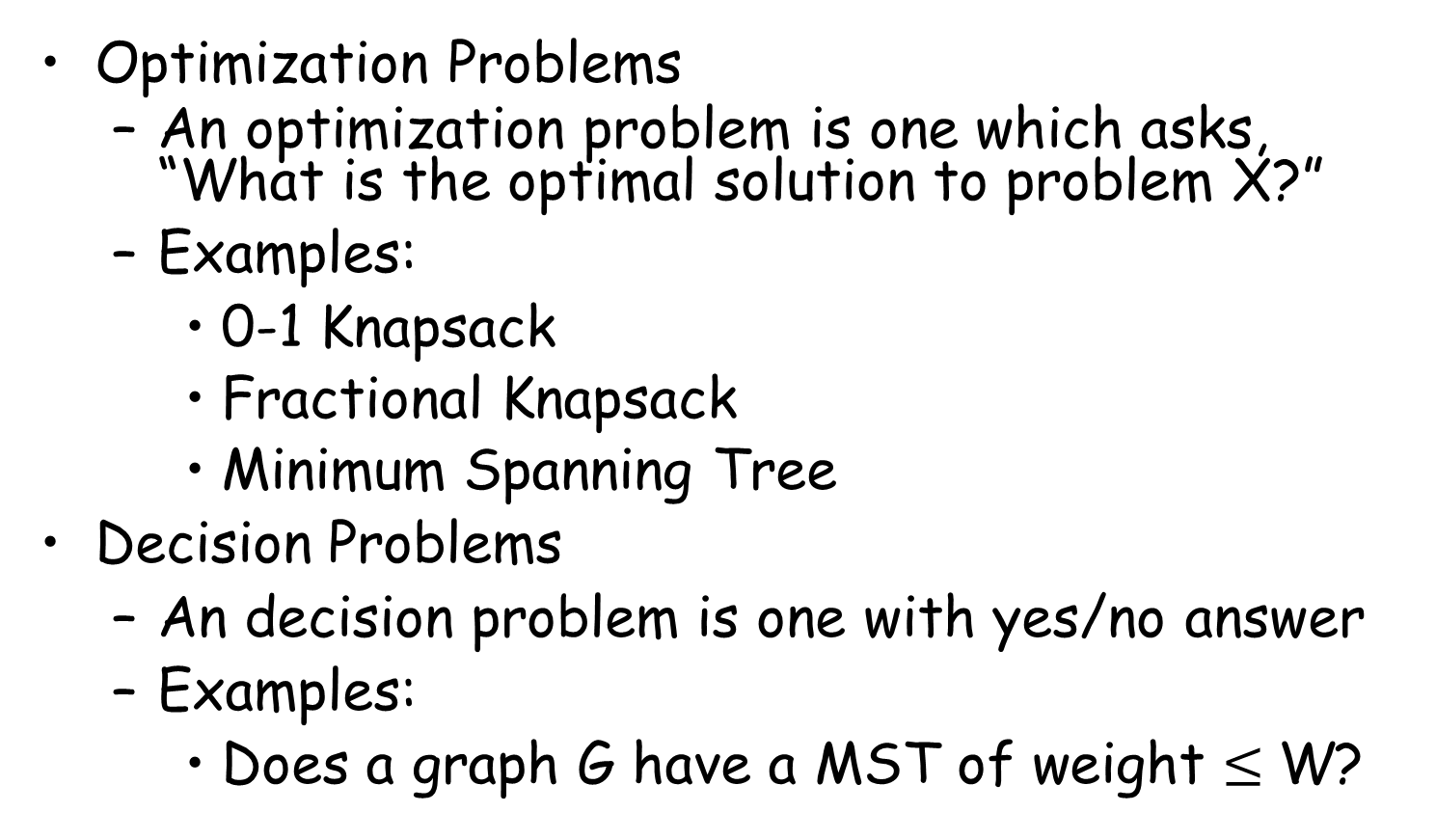
Optimization/Decision Problems
Optimization Problems
An optimization problem is one which asks, “What is the optimal solution to problem X?”
Examples:
0-1 Knapsack
Fractional Knapsack
Minimum Spanning Tree
Decision Problems
An decision problem is one with yes/no answer
Examples:
Does a graph G have a MST of weight $≤$ W?

Slide 6
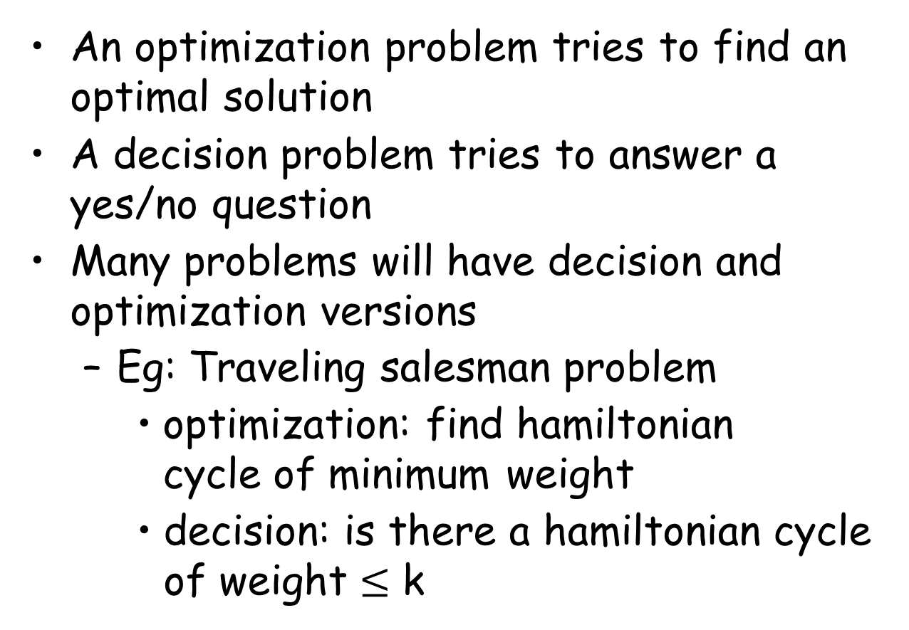
Optimization/Decision Problems
An optimization problem tries to find an optimal solution
A decision problem tries to answer a yes/no question
Many problems will have decision and optimization versions
Eg: Traveling salesman problem
optimization: find hamiltonian cycle of minimum weight
decision: is there a hamiltonian cycle of weight $≤$ k

Slide 7
Till now all the algorithm we have learned are classified and written below in two categories:
Polynomial based Algorithm
Linear Search
Binary Search
Insertion Sort
Merge Sort
Matrix Multiplication
etc…
Exponential based Algorithm
0/1 Knapsack
Travelling Salesman
Sum of Subset
N-Queen
Graph Coloring
Hamiltonian Cycle

Slide 8
P, NP, NP-Hard, NP-Complete
-Definitions

Slide 9
The Class P
P: the class of problems that have polynomial-time deterministic algorithms.
That is, they are solvable in O(p(n)), where p(n) is a polynomial on n
A deterministic algorithm is (essentially) one that always computes the correct answer

Slide 10
Sample Problems in P
Fractional Knapsack
MST (Minimum Spanning Tree)
Sorting
Others ?

Slide 11
The class NP
NP: the class of decision problems that are solvable in polynomial time on a nondeterministic machine (or with a nondeterministic algorithm)
(A determinstic computer is what we know)
A nondeterministic computer is one that can “guess” the right answer or solution
Think of a nondeterministic computer as a parallel machine that can freely spawn an infinite number of processes
Thus NP can also be thought of as the class of problems “whose solutions can be verified in polynomial time”
Note that NP stands for “Nondeterministic Polynomial-time”

Slide 12
Sample Problems in NP
Fractional Knapsack
MST
Others?
Traveling Salesman
Graph Coloring
Satisfiability (SAT)
the problem of deciding whether a given Boolean formula is satisfiable

Slide 13
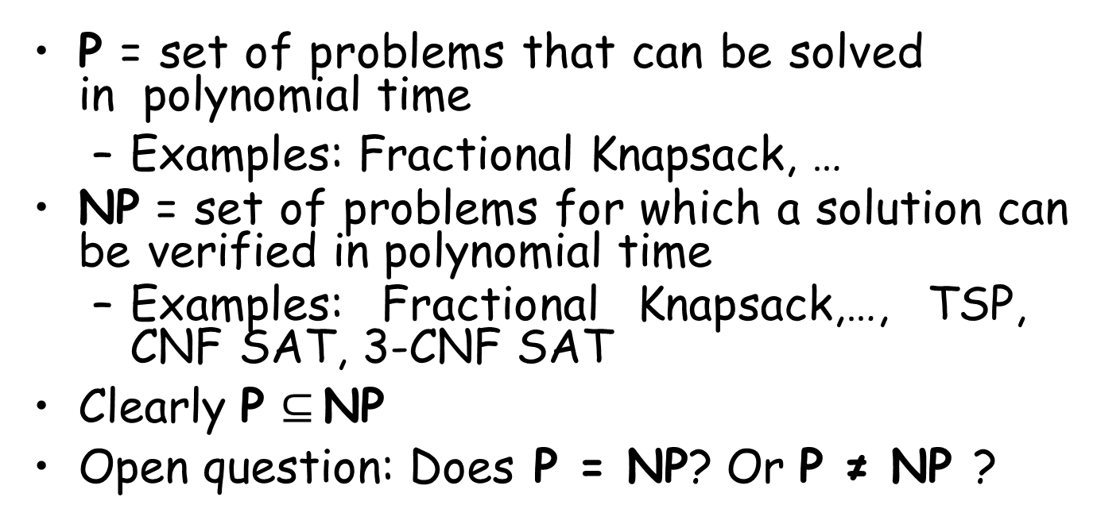
P And NP Summary
P = set of problems that can be solved in polynomial time
Examples: Fractional Knapsack, …
NP = set of problems for which a solution can be verified in polynomial time
Examples: Fractional Knapsack,…, TSP, CNF SAT, 3-CNF SAT
Clearly P $⊆$ NP
Open question: Does P = NP? Or P ≠ NP ?

Slide 14
NP-hard
What does NP-hard mean?
– A lot of times you can solve a problem by reducing it to a different problem. I can reduce Problem B to Problem A if, given a solution to Problem A, I can easily construct a solution to Problem B. (In this case, "easily" means "in polynomial time.“).
A problem is NP-hard if all problems in NP are polynomial time reducible to it, ...
Ex:- Hamiltonian Cycle (HC)
Every problem in NP is reducible to HC in polynomial time. Ex:- TSP is reducible to
HC.
B
A
Example: lcm(m, n) = m * n / gcd(m, n),
13

Slide 15
NP-complete problems
A problem is NP-complete if the problem is both
NP-hard, and
NP.

Slide 16
Reduction
A problem R can be reduced to another problem Q if any instance of R can be rephrased to an instance of Q, the solution to which provides a solution to the instance of R
– This rephrasing is called a transformation
Intuitively: If R reduces in polynomial time to Q, R is “no harder to solve” than Q
Example: lcm(m, n) = m * n / gcd(m, n),
lcm(m,n) problem is reduced to gcd(m, n) problem

Slide 17
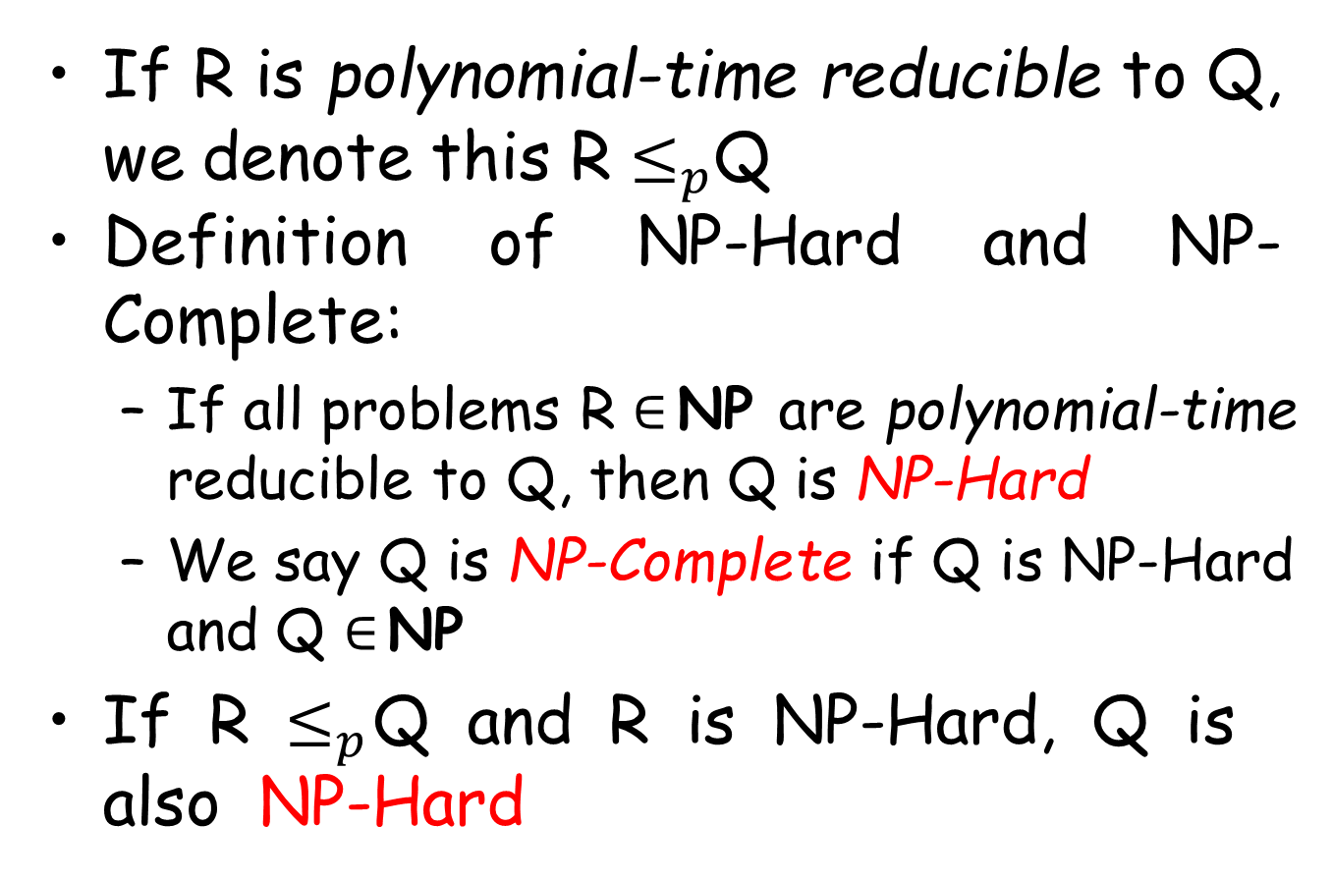
NP-Hard and NP-Complete
If R is polynomial-time reducible to Q, we denote this R $≤_{p}$Q
Definition of NP-Hard and NP- Complete:
If all problems R $∈$ NP are polynomial-time
reducible to Q, then Q is NP-Hard
We say Q is NP-Complete if Q is NP-Hard and Q $∈$ NP
If R $≤_{p}$Q and R is NP-Hard, Q is also NP-Hard

Slide 18
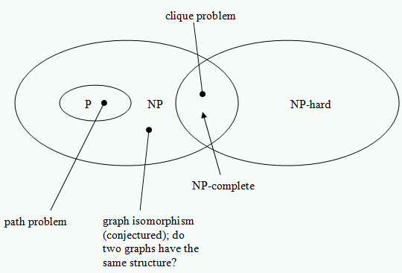
Relationship between P, NP, NP-Hard and NP-Complete

Slide 19
Summary
P is set of problems that can be solved by a deterministic Turing machine in Polynomial time.
NP is set of problems that can be solved by a Non-deterministic Turing Machine in Polynomial time. P is subset of NP (any problem that can be solved by deterministic machine in polynomial time can also be solved by non-deterministic machine in polynomial time) but P≠NP.

Slide 20
Summary
Some problems can be translated into one another in such a way that a fast solution to one problem would automatically give us a fast solution to the other.
There are some problems that every single problem in NP can be translated into, and a fast solution to such a problem would automatically give us a fast solution to every problem in NP. This group of problems are known as NP- Complete. Ex:- Clique Problem

Slide 21
Summary
A problem is NP-hard if an algorithm for solving it can be translated into one for solving any NP- problem (nondeterministic polynomial time) problem. NP-hard therefore means "at least as hard as any NP Problem" although it might, in fact, be harder.

Slide 22
First NP-complete problem (Circuit Satisfiability )
Problem definition
Boolean combinational circuit
Boolean combinational elements, wired together
Each element, inputs and outputs (binary)
Limit the number of outputs to 1.
Called logic gates: NOT gate, AND gate, OR gate.
true table: giving the outputs for each setting of inputs
true assignment: a set of boolean inputs.
satisfying assignment: a true assignment causing the output to be 1.
20

Slide 23
First NP-complete problem (Circuit Satisfiability )
Circuit satisfying problem: given a boolean combinational circuit composed of AND, OR, and NOT, is it stisfiable?
CIRCUIT-SAT={<C>: C is a satisfiable boolean circuit}
Implication: in the area of computer-aided hardware optimization, if a subcircuit always produces 0, then the subcircuit can be replaced by a simpler subcircuit that omits all gates and just output a 0.
23

Slide 24
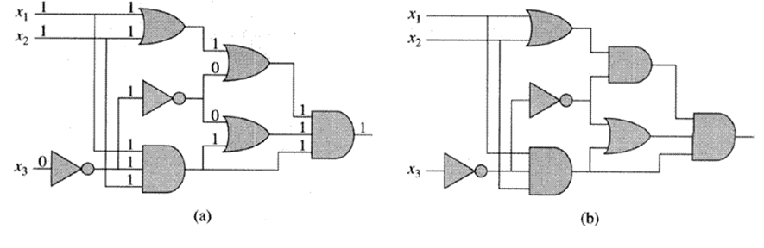
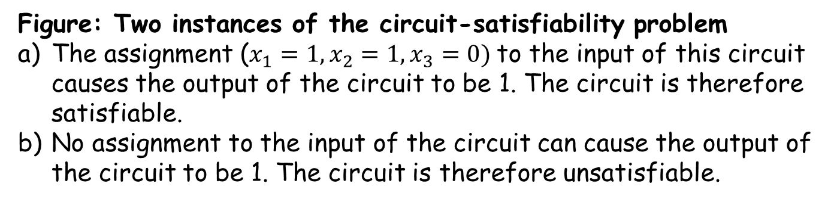
Two instances of circuit satisfiability problems
First NP-complete problem (Circuit Satisfiability )
Figure: Two instances of the circuit-satisfiability problem
The assignment ($x_{1}=1, x_{2}=1,x_{3}=0)$to the input of this circuit causes the output of the circuit to be 1. The circuit is therefore satisfiable.
No assignment to the input of the circuit can cause the output of the circuit to be 1. The circuit is therefore unsatisfiable.
24

Slide 25
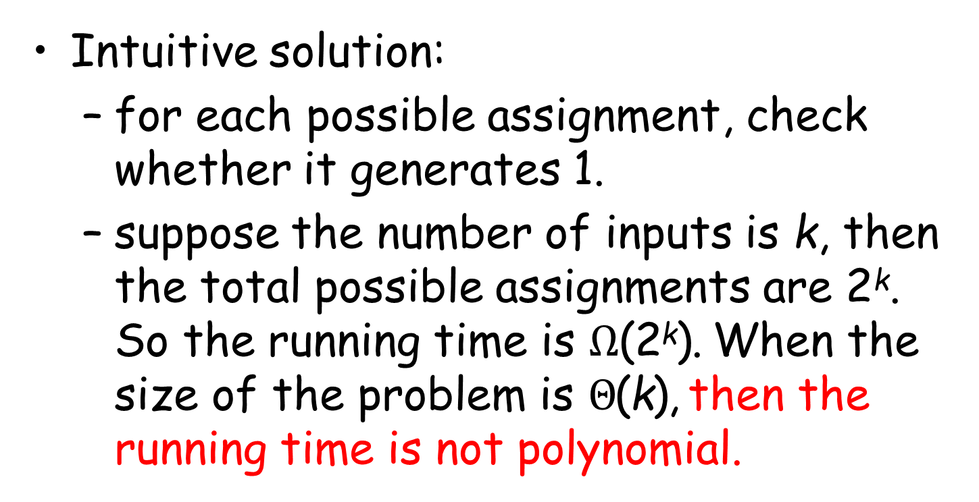
Solving circuit-satisfiability problem
Intuitive solution:
for each possible assignment, check whether it generates 1.
suppose the number of inputs is k, then the total possible assignments are 2^{k}.
So the running time is $Ω$(2^{k}). When the size of the problem is $Θ$(k), then the running time is not polynomial.
25

Slide 26
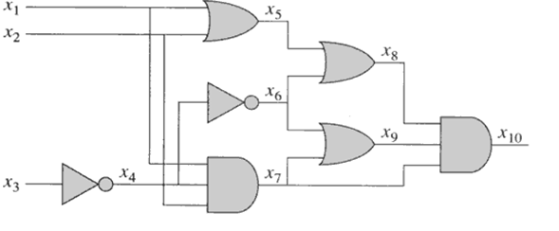
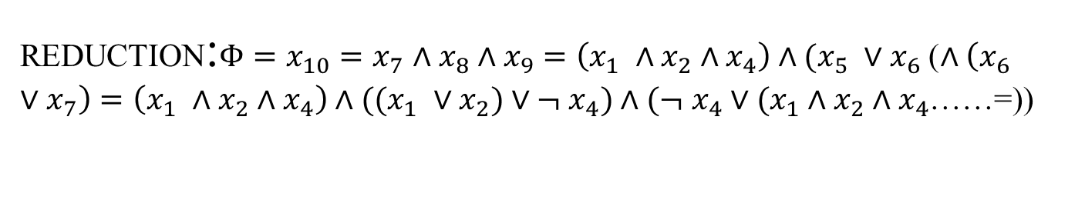
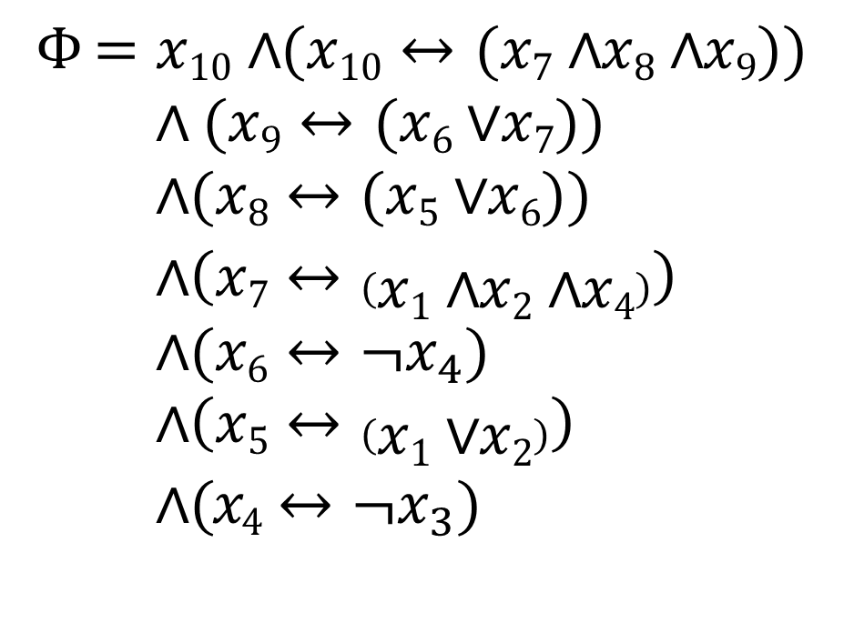
Example of reduction of CIRCUIT-SAT to SAT
$$Φ =x10∧(x10↔(x7∧x8∧x9))$$
$$∧ (x9↔(x6∨ x7))$$
$$∧(x8↔(x5∨x6))$$
$∧\left(x7↔\left(x1∧x2∧x4\right)\right)$
$$∧(x6↔¬x_{4})$$
$$∧\left(x5↔\left(x1∨x2\right)\right)$$
$∧(x4↔¬x_{3})$
REDUCTION:$Φ=x_{10}=x_{7}$ $∧x_{8}∧x_{9}=\left(x_{1} ∧x_{2}∧x_{4}\right)∧(x_{5} ∨x_{6}$) $∧\left(x_{6} ∨x_{7}\right)=\left(x_{1} ∧x_{2}∧x_{4}\right)∧((x_{1} ∨x_{2})∨¬$ $x_{4})∧(¬$ $x_{4}∨(x_{1}∧x_{2}∧x_{4}$))=……
26

Slide 27
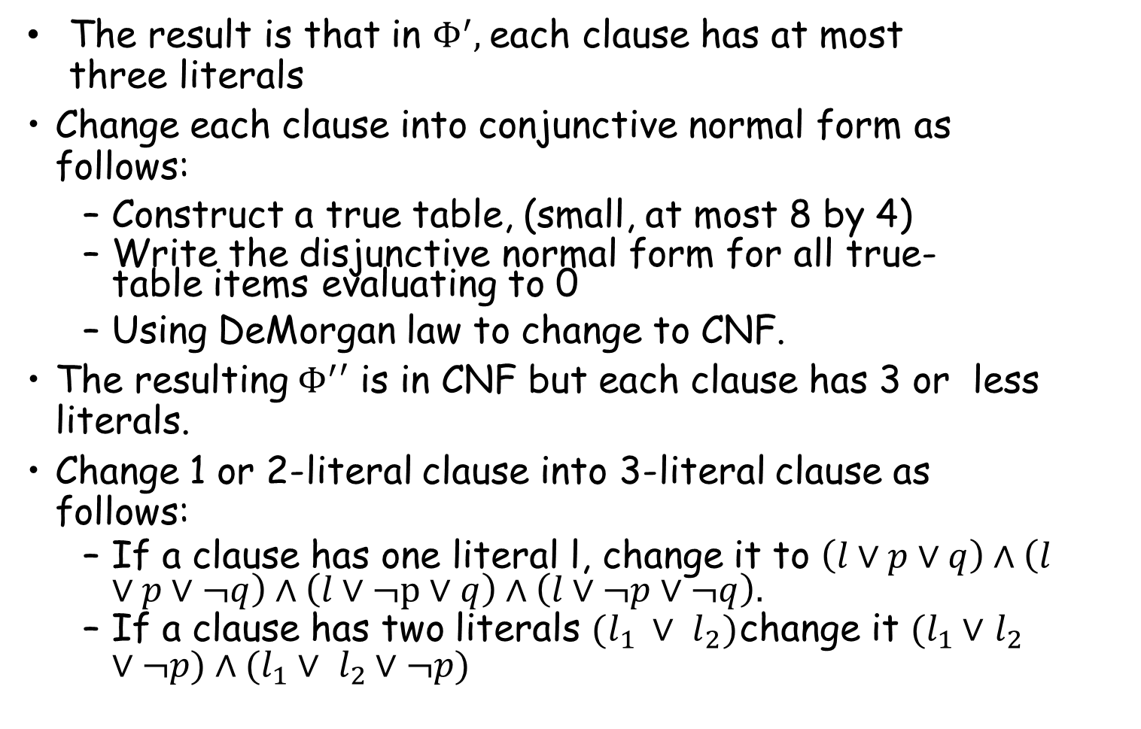
Conversion to 3 CNF
The result is that in $Φ^{′},$each clause has at most three literals
Change each clause into conjunctive normal form as follows:
Construct a true table, (small, at most 8 by 4)
Write the disjunctive normal form for all true-table items evaluating to 0
Using DeMorgan law to change to CNF.
The resulting $Φ^{′}′$ is in CNF but each clause has 3 or less literals.
Change 1 or 2-literal clause into 3-literal clause as follows:
If a clause has one literal l, change it to $\left(l∨p∨q\right)∧\left(l∨p∨¬q\right)∧\left(l∨¬p∨q\right)∧\left(l∨¬p∨¬q\right).$
If a clause has two literals $(l_{1 }∨ l_{2})$change it $(l_{1}∨$ $l_{2}∨¬p)∧(l_{1}∨ l_{2}∨¬p)$

Slide 28

Example of a polynomial-time reduction:
Now reduce the 3CNF-satisfiability problem to the CLIQUE problem $(i.e. 3Φ≤_{P}Clique)$

Slide 29
3CNF formula:
clause
literal
$$(x_{1}∨\overline{x_{2}}∨\overline{x_{3}})∧(x_{3}∨\overline{x_{5}}∨x_{6})∧(x_{3}∨\overline{x_{6}}∨x_{4})∧(x_{4}∨x_{5}∨x_{6})$$
Each clause has three literals
Language:
3CNF-SAT ={w : w is a satisfiable 3CNF formula}

Slide 30
A 5-clique in graph G
Definition of Clique: In a clique problem each node is connected to each other nodes of that graph.
Language:
CLIQUE = {< G, k >: graph G
contains a k-clique}

Slide 31
Transform formula to graph. Example:
$$(x_{1}∨x_{2}∨\overline{x_{4}})∧(\overline{x_{1}}∨\overline{x_{2}}∨\overline{x_{4}})(x_{1}∨x_{2}∨x_{3})∧(x_{2}∨\overline{x_{3}}∨\overline{x_{4}})$$
Clause 2
Create Nodes:
x
1
x
x₄
2
x₁
x₁
Clause 1
x₂
x₂
Clause 3
x₄
x₃
x₂
x₃
x₄
Clause 4

Slide 32

$$(x_{1}∨x_{2}∨\overline{x_{4}})∧(\overline{x_{1}}∨\overline{x_{2}}∨\overline{x_{4}})(x_{1}∨x_{2}∨x_{3})∧(x_{2}∨\overline{x_{3}}∨\overline{x_{4}})$$
x₁
x₂
x₄
x₁
x₁
x₂
x₂
x₄
x₃
x₂
x₃
x₄
Add link from a literal $ξ$to a literal in every other clause, except the complement$\overline{ξ}$

Slide 33
$$(x_{1}∨x_{2}∨\overline{x_{4}})∧(\overline{x_{1}}∨\overline{x_{2}}∨\overline{x_{4}})(x_{1}∨x_{2}∨x_{3})∧(x_{2}∨\overline{x_{3}}∨\overline{x_{4}})$$
x₁
x₂
x₄
x₁
x₁
x₂
x₂
x₄
x₃
x₂
x₃
x₄
Resulting Graph

Slide 34




$$(x_{1}∨x_{2}∨\overline{x_{4}})∧(\overline{x_{1}}∨\overline{x_{2}}∨\overline{x_{4}})(x_{1}∨x_{2}∨x_{3})∧(x_{2}∨\overline{x_{3}}∨\overline{x_{4}})$$
x₁ = 1
x₂ = 0
x₃ = 0
x₁ x₂
x₄
x₁
x₁
x = 1
4
x₂
x₂
x₄
x₃
x₂
x₃
x₄
The formula is satisfied if and only if the Graph has a 4-clique
The objective is to find a clique of size 4, where 4 is the number of clauses.
End of Proof
32

Slide 35
CIRCUIT-SAT
The side figure outline the structure of the NP- Completeness proof by using reduction methodology
SAT
3-CNF-SAT
CLIQUE
SUBSET-SUM
VERTEX-COVER
HAM-CYCLE
TSP

Slide 36
Theorem:
If: a. Language A
b. Language B
is NP-complete is in NP
c. A is polynomial time reducible to B
Then: B is NP-complete

Slide 37
Corollary:
CLIQUE is NP-complete
Proof:
3CNF-SAT is NP-complete
CLIQUE is in NP
3CNF-SAT is polynomial reducible to CLIQUE
(shown earlier)
Apply previous theorem with A=3CNF-SAT and B=CLIQUE

Slide 38
Previous Gate Questions

Slide 39
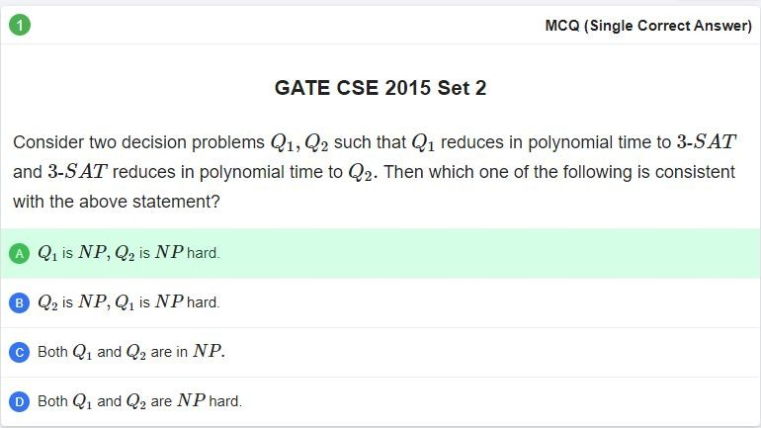
Q. No. 1

Slide 40
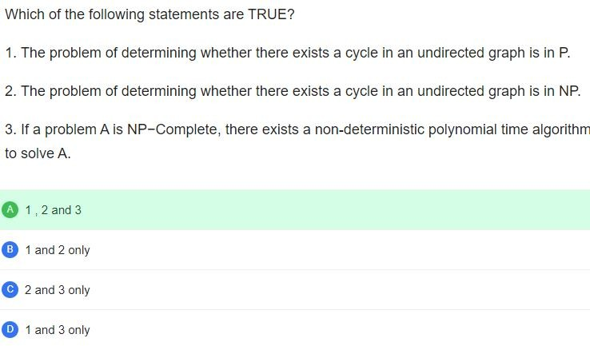
Q. No. 2

Slide 41
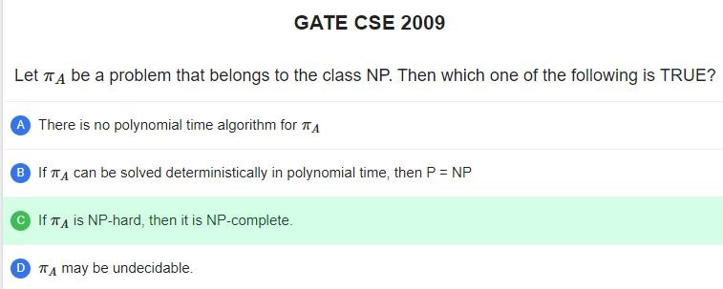
Q. No. 3

Slide 42
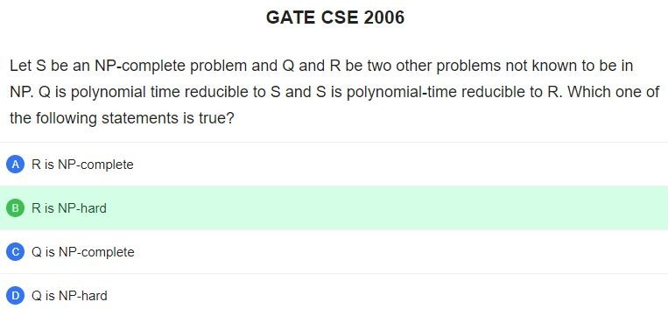
Q. No. 4

Slide 43
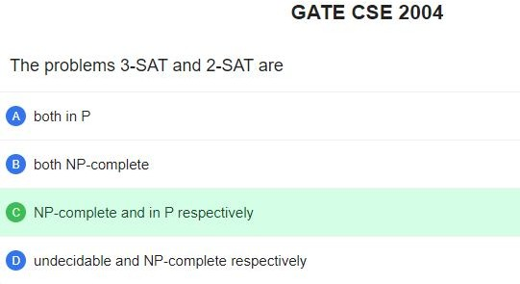
Q. No. 5

Slide 44
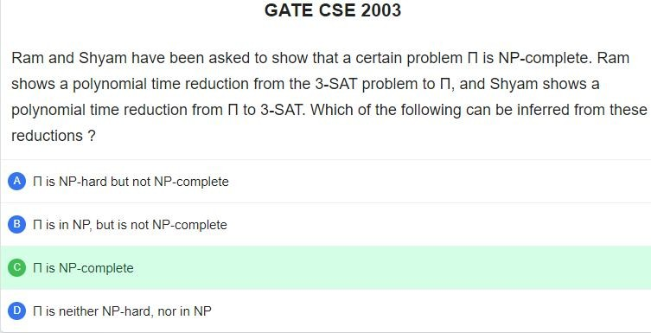
Q. No. 6

Slide 45
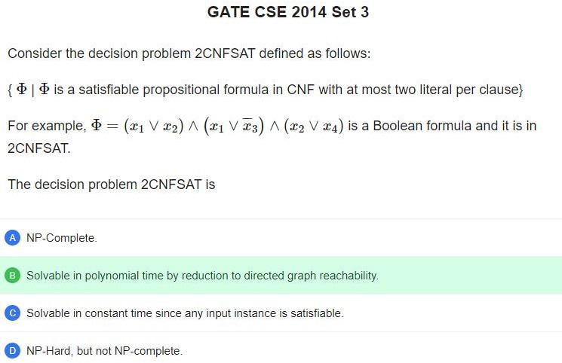
Q. No. 7

Slide 46
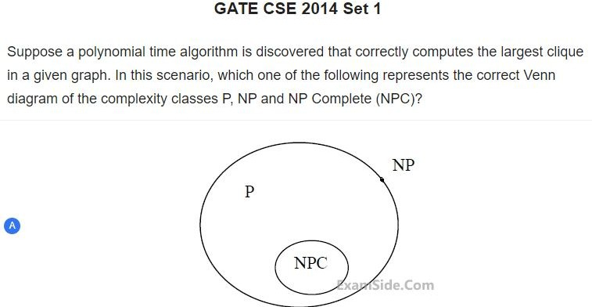
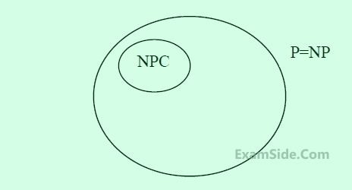
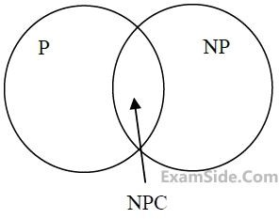
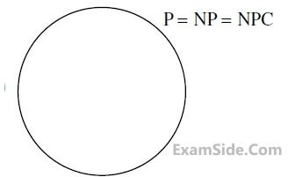
Q. No. 8

Slide 47
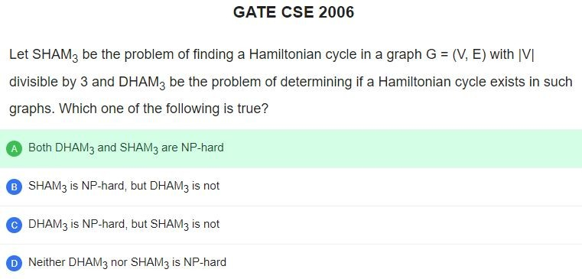
Q. No. 10
There exist: search problem
Explanation: The problem of finding whether there exist a Hamiltonian Cycle or not is NP Hard and NP Complete Both.
Finding a Hamiltonian cycle in a graph G = (V,E) with V divisible by 3 is also NP Hard.

Slide 48
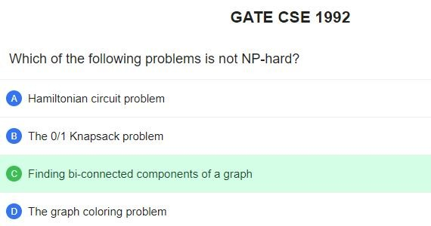
Q. No. 11

Slide 49
Thank You

